Slide 1

Introduction to Cucumber
Presented by Jared Sheffer

Slide 2
Overview
What are BDD & ATDD?
What is Gherkin?
What is Cucumber?
What is a Step Definition?

Slide 3
What are BDD & ATDD?
Behavior Driven Development
Describes overall behaviors of the system
Customer focused
Acceptance Test Driven Development
Defines tests which act as requirements for the system
Development focused
Acceptance Tests are intended to fail at the beginning until the development is completed for the Acceptance Test requirement
Notes:
ATDD : Are acceptance tests which represent the user's point of view and act as a form of requirements to describe how the system will function
- You write the tests which will fail until the system is built correctly.
BDD is generally more generic and high level and tends to be more customer focused.
They are both Very similar.
Cucumber more or less seeks to combine these two concepts in a way the whole organization can understand.

Slide 4
What is Gherkin?
Gherkin is the language Cucumber uses to define test cases
Non-technical
Human readable
Helps enforce firm, unambiguous requirements
Notes:
Gherkin doesn’t have to be connected to cucumber or test automation.
Many use it as a standardized way of creating requirements in the form of acceptance tests

Slide 5
What is Gherkin? Keywords
Keywords
Given precondition
And precondition
When action
And action
And action
Then results
Notes:
Gherkin is written in plain English (Or what ever language you are using). It is meant to be readable by anyone. By Following the gherkin standards on when to use what keyword it helps promote standardization and readability.

Slide 6
Given, When, Then, But or And
Given – Precondition or setup (Must be first)
When – Action
Then – Assertion (Must be last)
And, But – Wild cards (They match the keyword above them)
But – Generally negative assertion

Slide 7
What is Cucumber?
Open source tool for test automation
Tests are written in Gherkin
Uses regular expressions to match Gherkin to a Cucumber step
Cucumber step is what wraps the automation code
Cucumber has implementations in:
Ruby, Jruby, Java, Groovy, Javasctipt, .NET, PHP, C++, etc…
Notes:
Cucumber was originally developed for use with Ruby but has since been ported to many different languages.
Cucumber will take a feature file as an input and try to find corresponding code to execute for each step.

Slide 8
What is Cucumber? Feature File
Features files have a .feature extension
Features → Scenarios → Steps
Notes:
A feature file is a description of a single feature of an application
Login would be an example of this
A feature file contains multiple tests
These are called scenarios
Scenarios contain steps written in the Given, When, Then Gherkin format

Slide 9
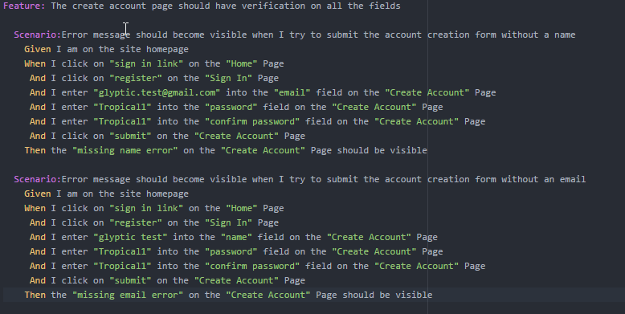
What is Cucumber? Feature File
Features → Scenarios → Steps
Notes:
There is only one Feature: keyword in a feature file but there are multiple Scenario: or Scenario Outline: keywords.

Slide 10
What is Gherkin? Real World Example
Given I am on the homepage
When I login as “gherkin_test”
And I navigate to the “My Account” page
And I click on the “My Lists” element on the “My Account” Page
Then I should be on the “My Lists” page
Notes:
Given(precondition) – I am on the homepage
When (Action) – I login as “gherkin_test”
And (Connected to above step. i.e. When) I navigate to the “My Account” page
And (Action again)
Then (Results) – I should be on the “My List” page

Slide 11
Gherkin: Scenario Outline
A Scenario Outline will run as a unique scenario for each line in it’s examples table

Slide 12
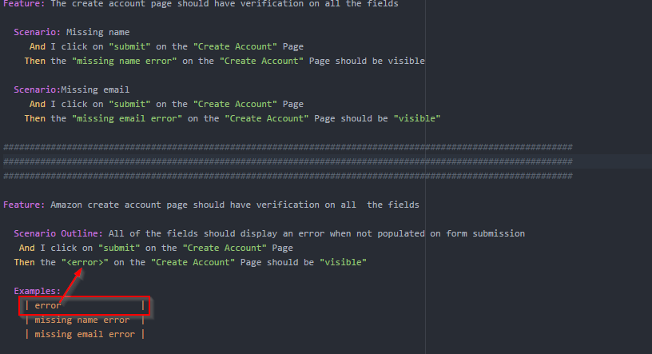
Gherkin: Scenario Outline
Notes:
The top two examples are truncated scenarios. I have removed the other steps to prevent confusion.
These two features will execute the same tests but the scenario outline does it in a cleaner and more maintainable manner.
First thing to know is that the string you want to replace has to be surrounded with the angle brackets <>
And it has to match the correct header from the examples table.
We use “” to help show what words are parameters and can be easily swapped out.

Slide 13
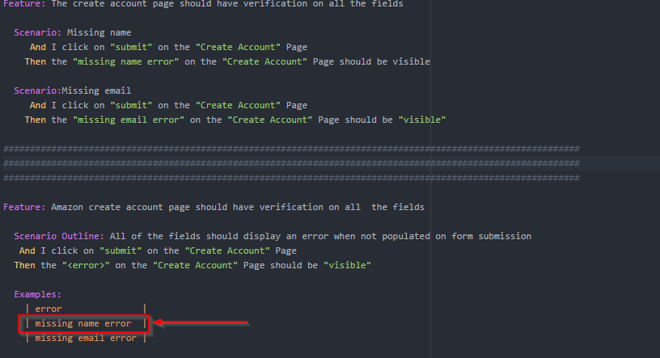
Gherkin: Scenario Outline
Notes:
When you run the scenario outline test it executes using the data from the first row.
You can have multiple rows and multiple columns

Slide 14
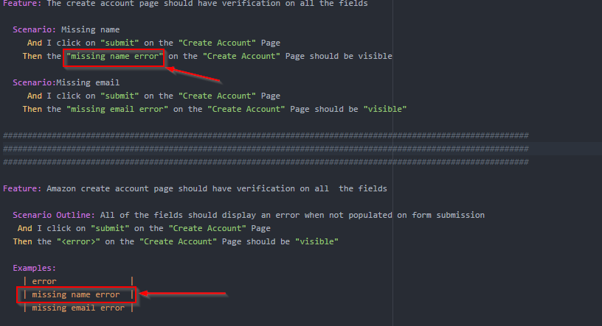
Gherkin: Scenario Outline
Notes:
When it executes it automatically act as if the fist row in the examples have replaced the <> placeholders
In this example the first run of the scenario outline will execute exactly the same as the first scenario above.

Slide 15
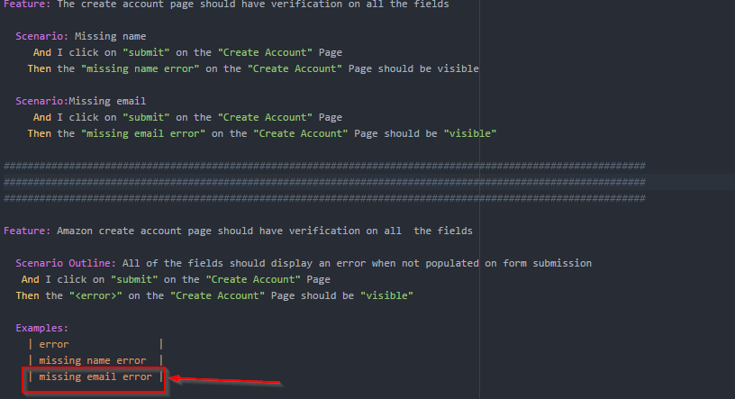
Gherkin: Scenario Outline
Notes:
After the completion of the first run the scenario outline will start over at the first step
It will execute the second time using the second row in the examples table

Slide 16
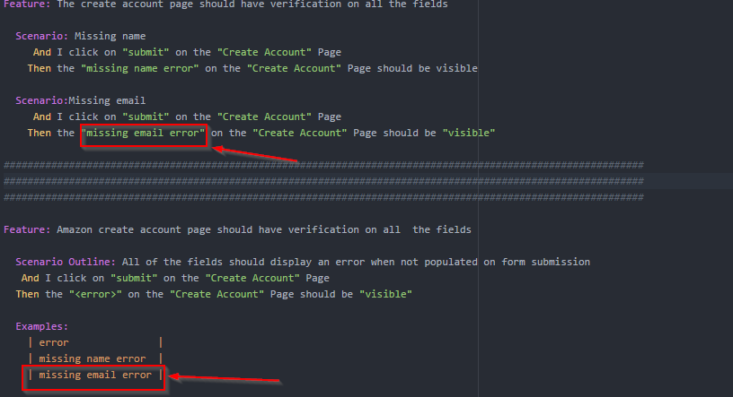
Gherkin: Scenario Outline
Notes:
Just like the first loop it will execute the second loop replacing the <error> placeholder with its row data in the table at runtime.

Slide 17
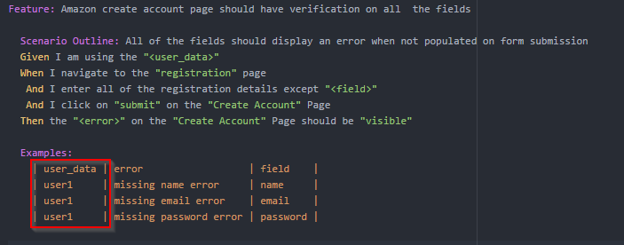
Gherkin: Scenario Outline
Notes:
The examples table is only for data which you want to change for each loop
If the data never changes don’t put it in the Examples
Place it directly in your step

Slide 18
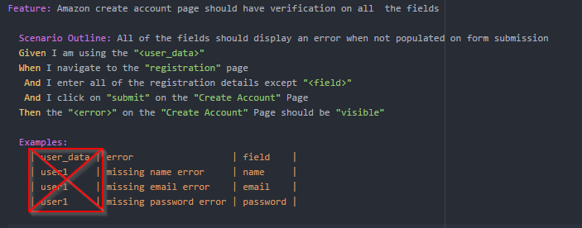
Gherkin: Scenario Outline
Notes:
The examples table is only for data which you want to change for each loop
If the data never changes don’t put it in the Examples
Place it directly in your step

Slide 19
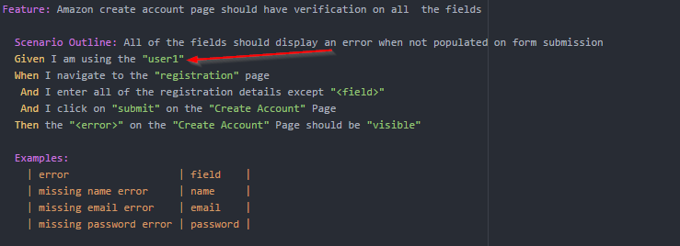
Gherkin: Scenario Outline
Notes:
The examples table is only for data which you want to change for each loop
If the data never changes don’t put it in the Examples
Place it directly in your step

Slide 20
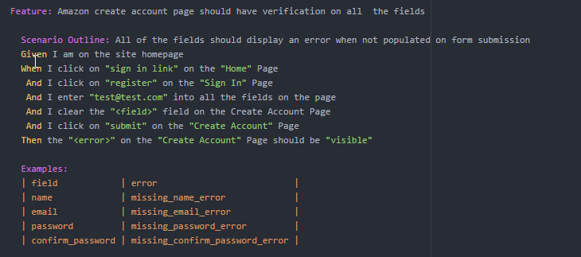
Gherkin: Scenario Outline
Notes:
This is an example where 4 different scenarios were combined into a single scenario outline.
If there is only one row in an example table then don’t use a scenario outline.
If the parameter has <> angle brackets it must be in the examples table.
If the parameter never changes don’t put it in the examples table

Slide 21
Gherkin: Steps Table
Scenario outlines
Example Table → Loop full scenario for each row
Step Table → All data is used in at once
Notes:
We also have another type of table called a Data Table or Step Table

Slide 22
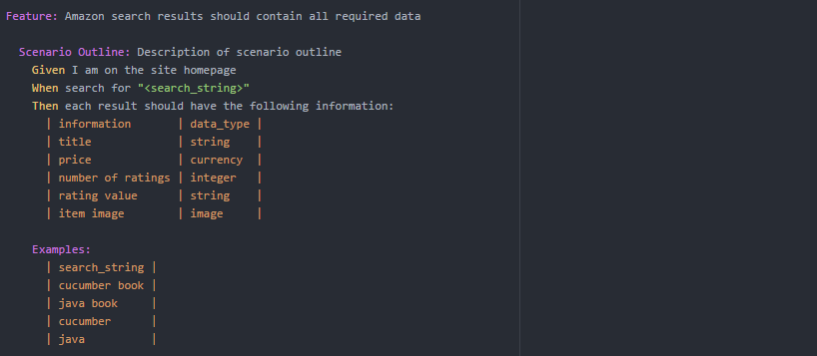
Gherkin: Steps Table
Notes:
In this example the scenario contains both a step table and a scenario outline example table
Notice the Scenario Outline table must be at the bottom under the Examples: keyword but the Step Table is right after the corresponding step.

Slide 23
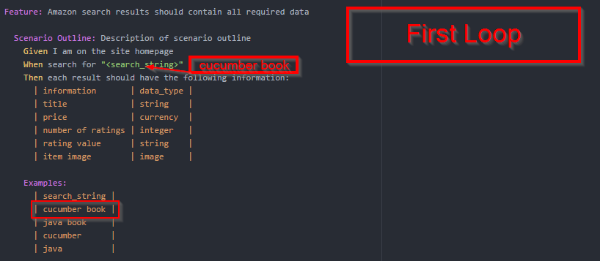
Gherkin: Steps Table
Notes:
As we discussed previously scenario outlines will execute in a loop. Each loop using a different row of data.

Slide 24
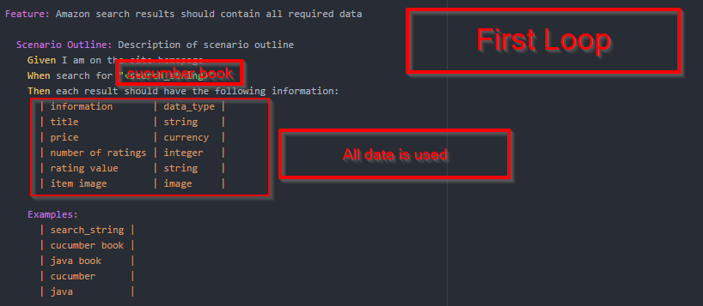
Gherkin: Steps Table
Notes:
But on each loop unlike an examples table a step table will use all the data in its table every time it is ran.
So each time we loop the examples table we are verifying all using all of the data from the step table each time.

Slide 25
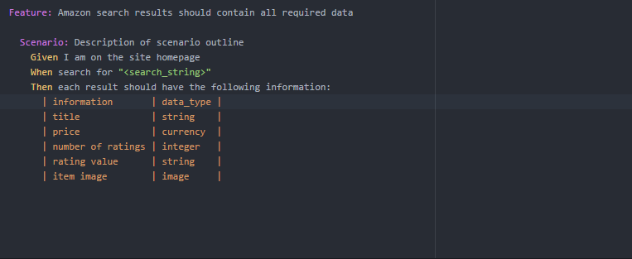
Gherkin: Steps Table
Notes:
A Step table can be used in a standard scenario as well.

Slide 26
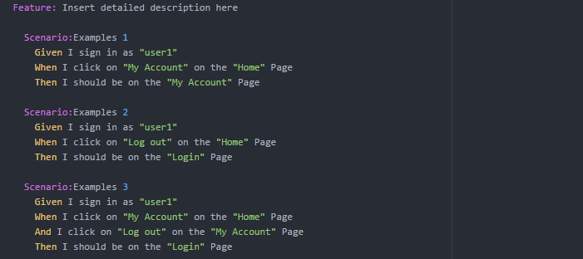
Gherkin: Background
Notes:
A background is a common step which happens before each scenario. This usually includes some kind of precondition or setup which has to happen for ever single scenario in a feature file.
If there are any scenarios where the first step is not the same as the background then you can not use a background
You cannot use data from an example table in a background

Slide 27
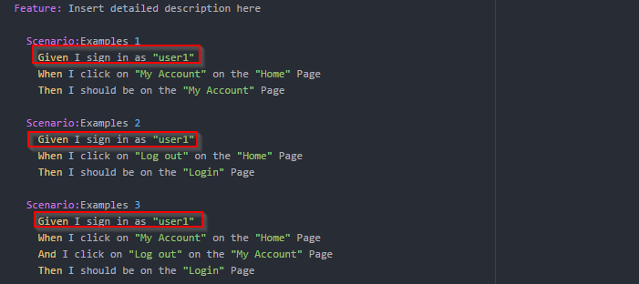
Gherkin: Background
Notes:
In this example we have 3 scenarios where the first step is always the same.

Slide 28
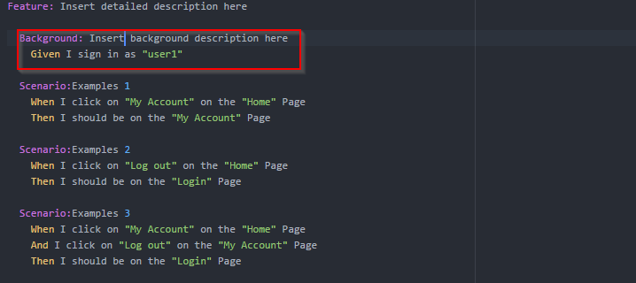
Gherkin: Background
Notes:
Since each scenario has the same precondition we can move it out into a background.
Backgrounds can be more than 1 step

Slide 29
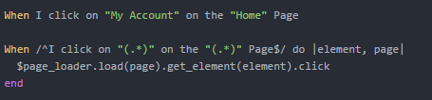
What is a Step Definition?
Notes:
A step definition is how cucumber matches the plain English step to a section of executable code.
This is step which will match the above step and use anything in the quotes “” as parameters in the step_definition
Given when and then are ignored

Slide 30
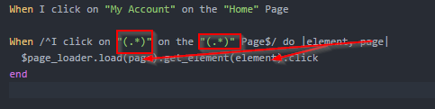
What is a Step Definition?
Notes:
The parameters from the step can be used in the implantation language.
In this example I am using Ruby with a page object model.

Slide 31
Questions?
Notes:
The parameters from the step can be used in the implantation language.
In this example I am using Ruby with a page object model.

